Slide 1

OMIS 697 – Digital Transformation Strategy November 28, 2022

Slide 2

Group Members
Bramma Sakthi Panneerkai Perumal (Z1938932)
Hita Gurunath Kadam (Z1908140)
Rahul Kumar Vellaturi (Z1937768)
Sri Sai Surya Gutta (Z1937378)
Vishnu Sai Teja Swarna (Z1975087)

Slide 3
Agenda
Introduction
Company Background
Part A – Digital Challenges
Part B – Digital Vision
Part C – Self Assessment
Where to go from here?
Recommendations
Conclusion

Slide 4
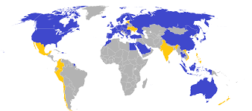
Introduction
IKEA - Ingvar Kamprad Elmtaryd Agunnaryd
“Creating a better everyday life for many people”
474 IKEA stores in 64 marketplaces
70000 employees in 42 countries
€41.9 Billion
IKEA

Slide 5
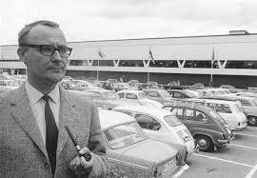
Company Background
Who?
When?
Where?
Why?
How?
What?
IKEA is a Swedish company
Headquarters in Netherland.
Its manufactures furniture, kitchen appliances, home accessories.

Slide 6
Company Background
Who?
When?
Where?
Why?
How?
What?
Founded in 1943
First started with selling matches, pens etc
First showroom in 1953

Slide 7
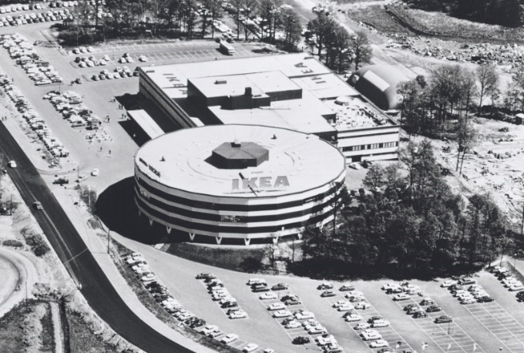
Company Background
Who?
When?
Where?
Why?
How?
What?
-IKEA was started in 1958 in Almult with name of “Mobel - IKEA”.
-Started in Norway as first store outside of Sweden in 1963.

Slide 8
Company Background
Who?
When?
Where?
Why?
How?
What?
The main vision of IKEA is to sell a wide range of furniture options to customers focusing mainly on the cost.
IKEA sells almost all household amenities at a very affordable price which are attractive yet simple.

Slide 9
Company Background
Who?
When?
Where?
Why?
How?
What?
IKEA started concentrating on interior design, furniture, kitchen appliances, and other home accessories.
They started expanding their range of products from matches to furniture.

Slide 10
Company Background
Who?
When?
Where?
Why?
How?
What?
Ingvar came up with the idea of making furniture and furnished products.
The reason behind the birth of IKEA is the presence of fewer manufacturers in Smaland.
In 1953, IKEA started the flat pack policy.
Products were sold without assembling the parts

Slide 11
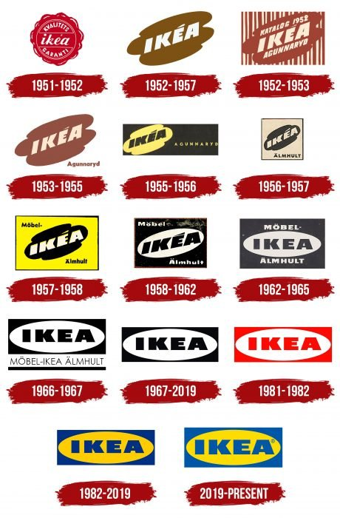
Company Background
World’s largest furniture retailer.
Offers 9500 products

Slide 12
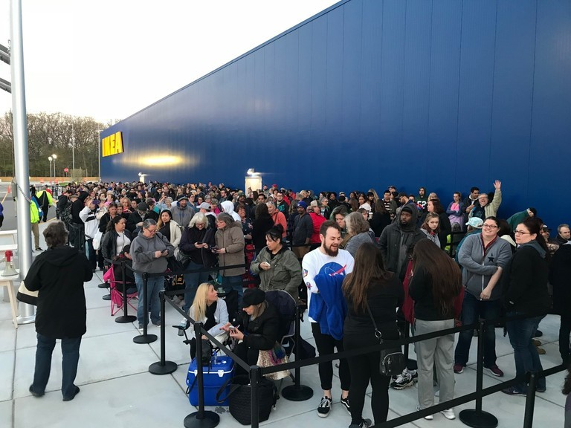
Part A: Digital Challenges
With smart stores which are digitized, not all age groups of customers are interested.
30% sales online, 70% sales in-store.
Crowd management systems.

Slide 13
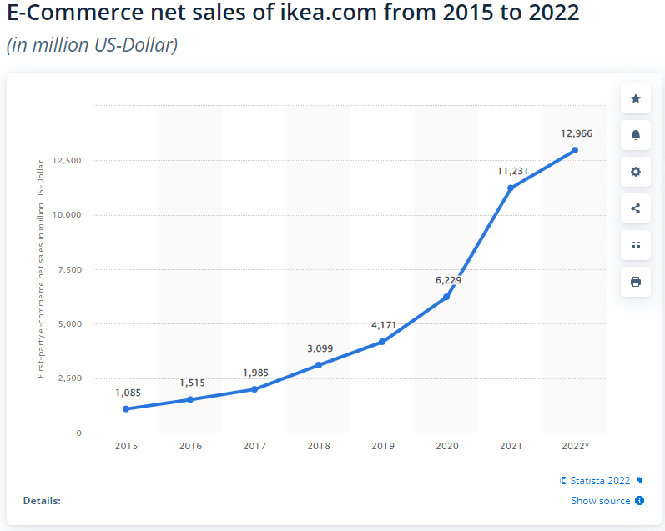
E-commerce Net Sales

Slide 14
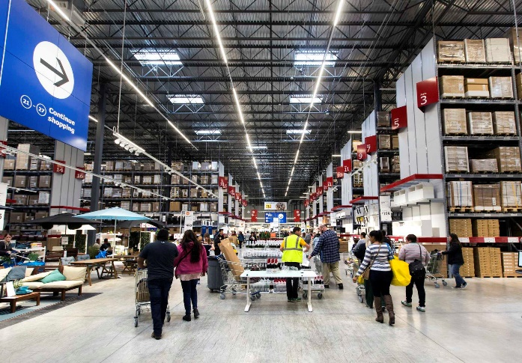
Part A: Digital Challenges Cont.
Investing in product analysis to better understand the product life cycle.
Logistics and supply chain issues with legacy systems.
Automating their core operations.

Slide 15
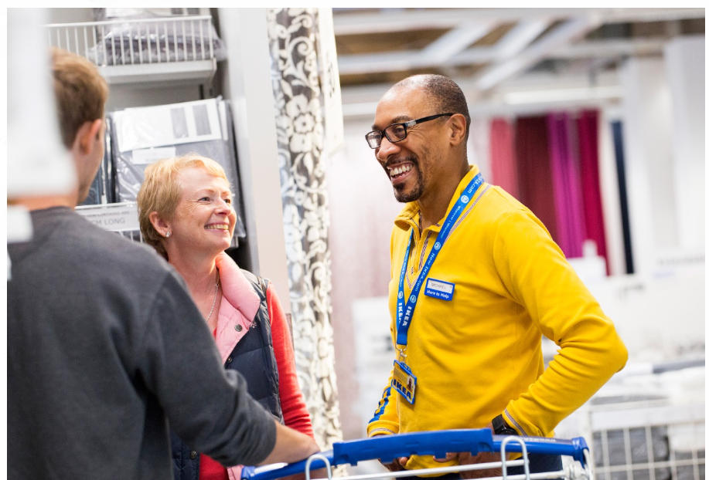
Part B: Digital Vision
We want to give the customer inside the Ikea store a wonderful digital experience by fully utilizing the capabilities of digital technology.
Real-time customer monitoring to help various categories of customers.

Slide 16
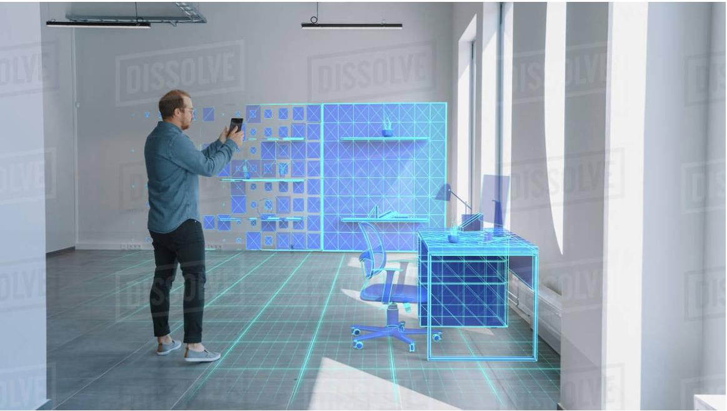
Part B: Digital Vision Cont.
We want the customer to visualize the selected products to see if they fit them better or not.
We encourage the scan-and-go method to reduce the waiting period in the queues.

Slide 17
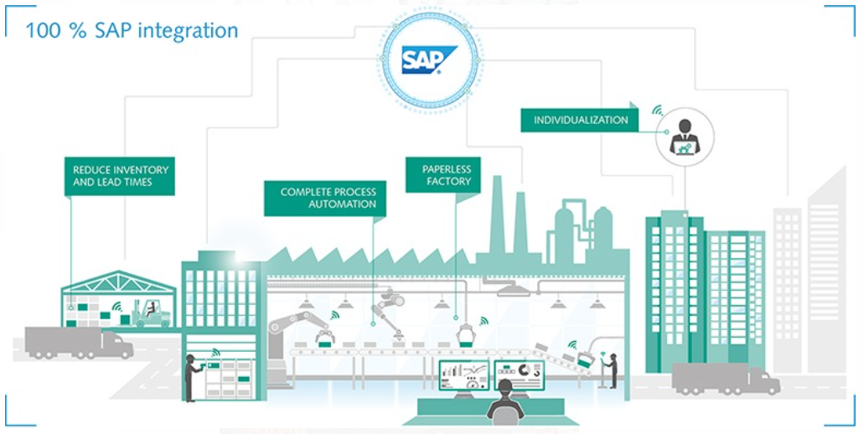
Part B: Digital Vision Cont.
Enhancing the backend automation process using the SAP ERP cloud platform to deliver the products to the customer.

Slide 18
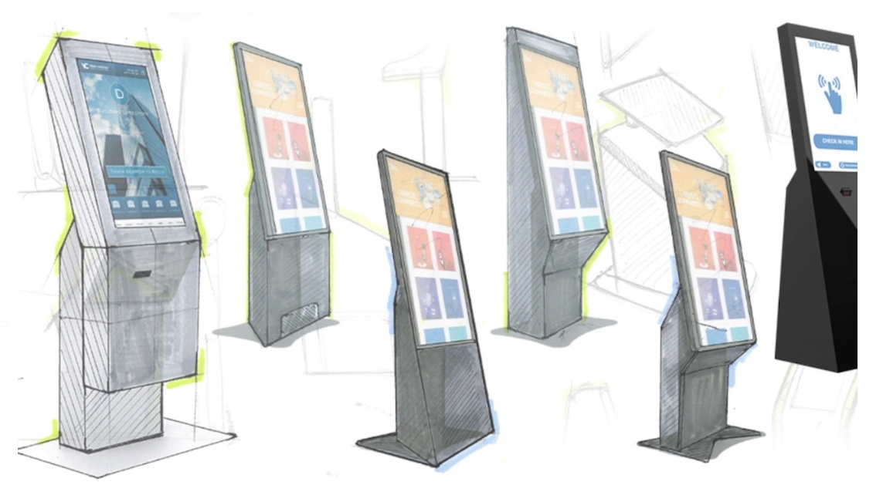
Part B: Crafting the vision
Smart Devices - Kiosk and Smart tablets powered by IKEA.
Digital shopping enabled in-store.

Slide 19
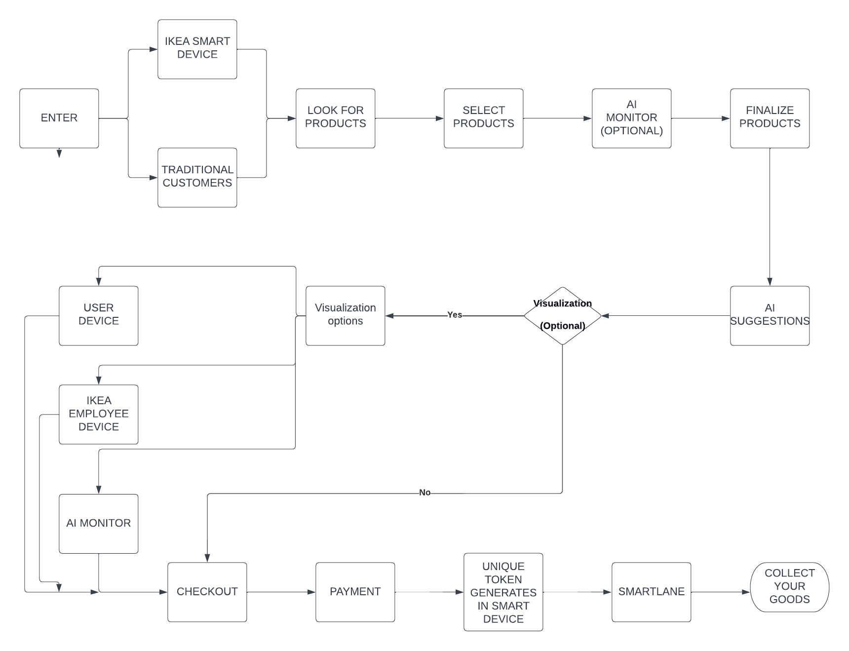
Front-end Operations

Slide 20
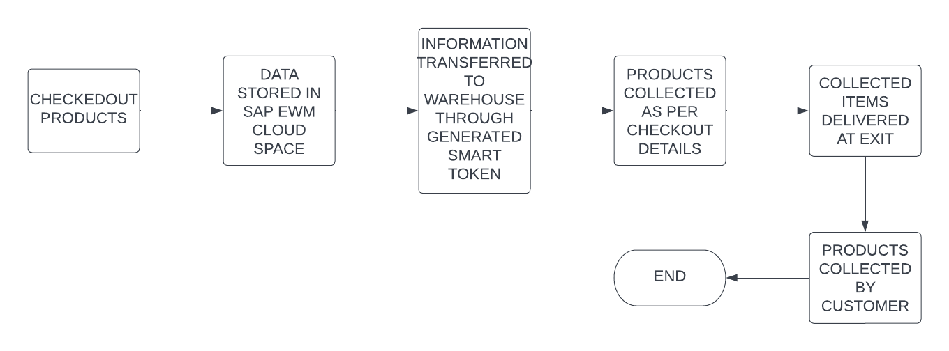
Backend Operations

Slide 21
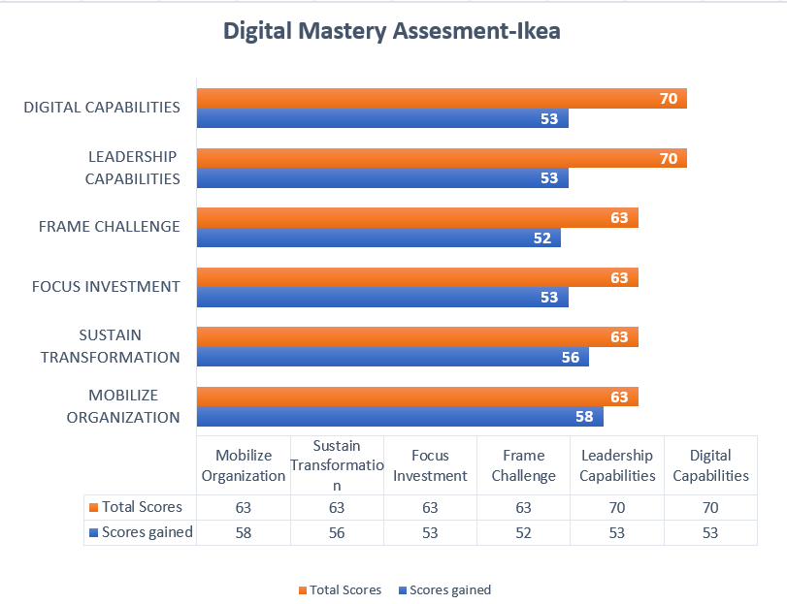
Digital Mastery Assessment

Slide 22
Digital Mastery Assessment

Slide 23
Digital Capabilities
How well does Ikea building its digital capabilities?
ARKit app for iOS user
Email Marketing and Mobile Marketing
AI chatbots, emails, and websites
Product recommendation using smarter analytics

Slide 24
Leadership capabilities
How well is Ikea building leadership capabilities?
Transformative vision
Investing in Digital skills
Digital initiatives across silos
Promotes cultural changes for digital transformation
IT and business leaders

Slide 25
Frame Challenge
Do they understand starting point?
Is the top team aligned around a shared digital vision?
Do they understand their starting point?

Slide 26
Focus Investment
Translating vision into action
Choosing right governance model
Funding models for the transformation

Slide 27
Mobilizing organization
Does Ikea make its ambition clear enough?
Are they creating sufficient momentum within the organization?
Do they actively encourage a digital cultural shift across the organization?

Slide 28
Sustaining transformation
Foundational capabilities
Reward structure and transformation goals
Measuring and monitoring digital progress

Slide 29
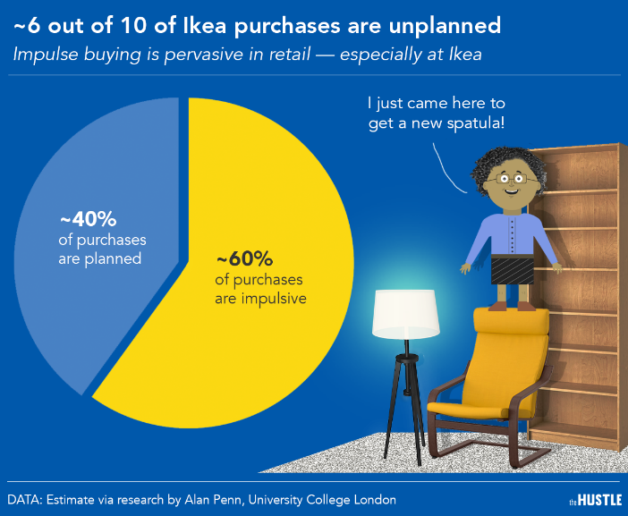
Where do you go from here?
They are on a mission to become a circular business by 2030.
Recently invested in Optoro, a tech company that will support us in optimizing returns.
Good for both business and the planet.
Industrial design – Industry 4.0 in generative design.
Enhance customer experience & engagement.
Having a strategic roadmap can make the percentages vice-versa.

Slide 30
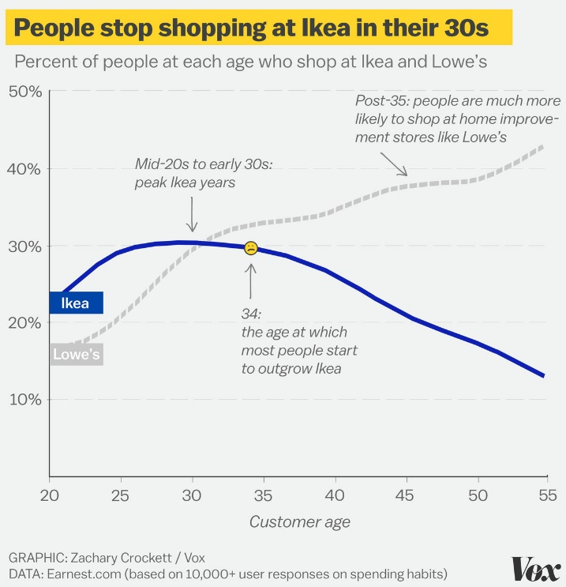
Where do you go from here? Cont.
Analyze and repair existing processes rather than build a new ones.
Few reasons for this curve to fall are long queues, difficulty in carrying out products which could be improved through smart shopping, e-commerce, etc.
Double the online sales contribution from 26% of the total sales.
Implement SAP Intelligent RPA.

Slide 31
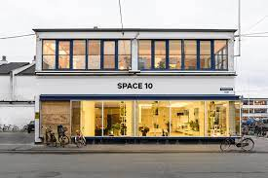
New Channels, Tools, Acquisitions
Geo magical labs
IKEA Kreativ
IKEA Place app
Task Rabbit
Space 10

Slide 32
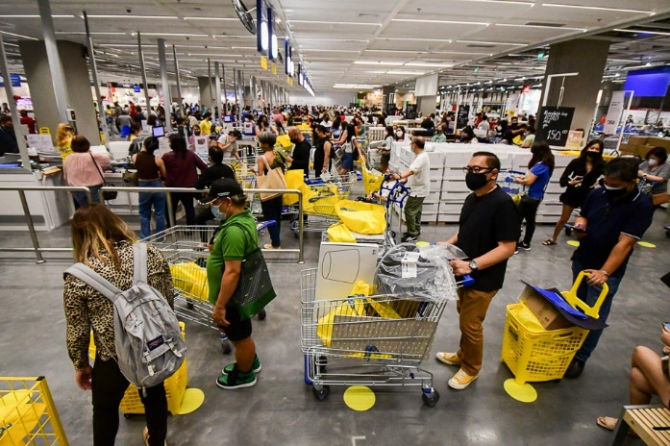
Recommendations
Accessible stores in urban areas with self-checkout options.
Opting for cloud solutions like SAP EWM (Extended Warehouse Management) to digitize their complete distribution center and warehouse operations to get rid of complex logistics execution.
Build sophisticated crowd management, a system with an omnichannel strategy.
Reduce customer footprint inside the stores with digital platforms and ecosystems.

Slide 33
Conclusion
Currently IKEA is on the way to becoming a digital master in a few years.
With strong leadership capabilities, growing themselves to increase their digital capabilities.
Glad we choose IKEA which helped us learn how a non-IT company can implement digital transformation.

Slide 34


